Slide 1
Secure Software Design and Development (Part II: Seven Touchpoints for Software Security)
Chapter 3. Introduction to Software Security Touchpoints
Book: Software Security: Building Security In, 1st Edition by Gary McGraw

Slide 2
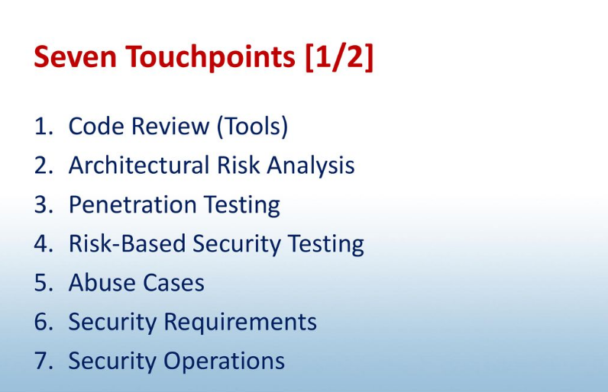
Seven Touchpoints

Slide 3
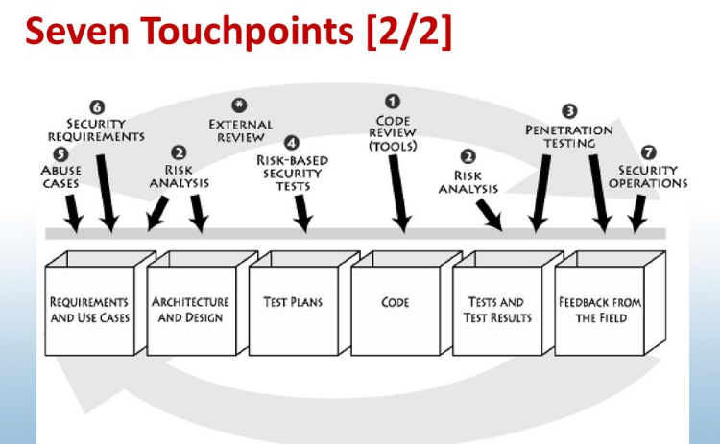
Seven Touchpoints

Slide 4
1. Code Review (Tools)
Artifact: Code
Example of risks found: Buffer overflow on line 42
Doing code review alone is an extremely useful activity, but given that this kind of review can only identify bugs, the best a code review can uncover is around 50% of the security problems.
Architectural problems are very difficult (and mostly impossible) to find by staring at code. This is especially true for modern systems made of hundreds of thousands of lines of code.
A comprehensive approach to software security involves holistically combining both code review and architectural analysis.

Slide 5
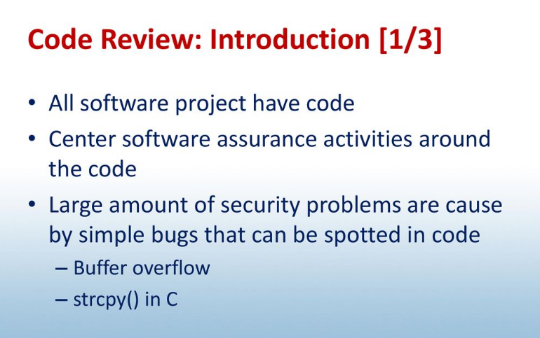
1. Code Review

Slide 6
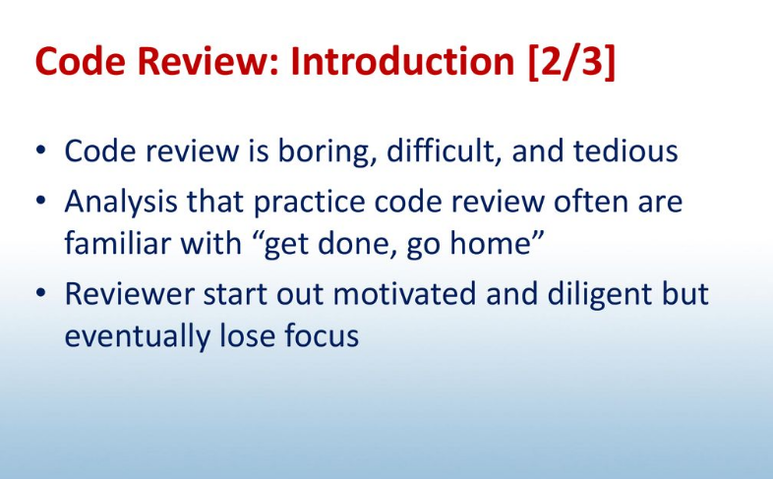
1. Code Review

Slide 7
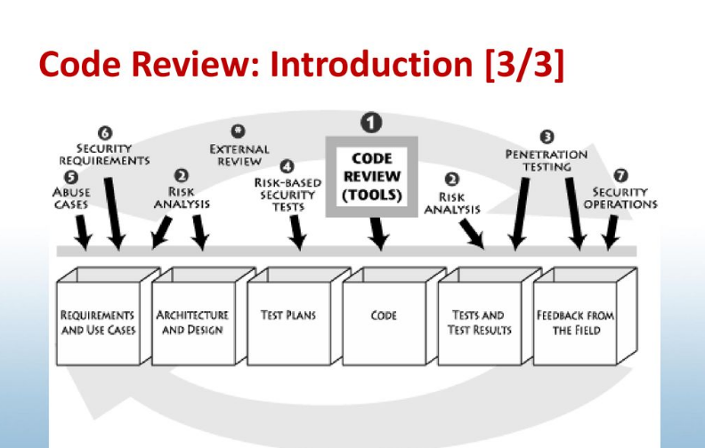
1. Code Review

Slide 8
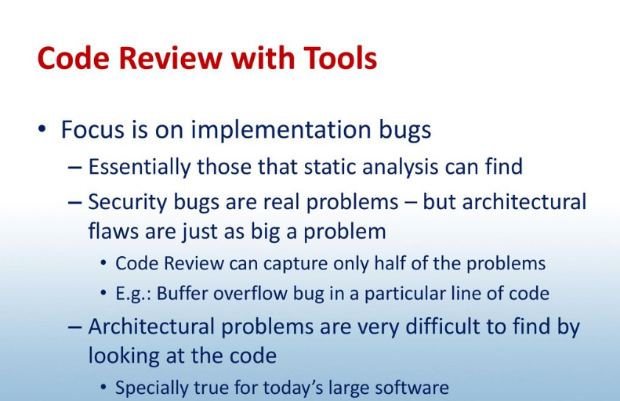
1. Code Review

Slide 9
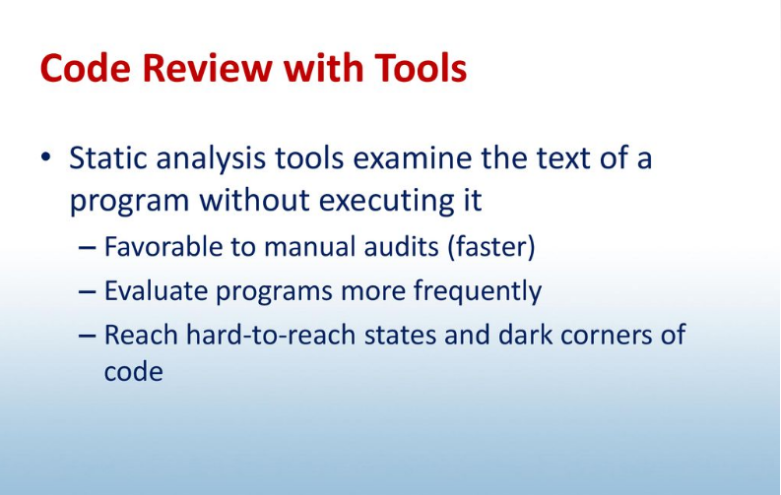
1. Code Review

Slide 10
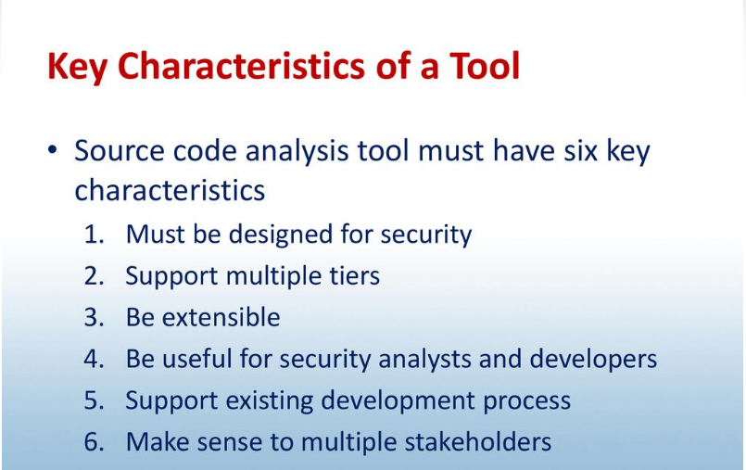
1. Code Review

Slide 11
2. Architectural Risk Analysis
Artifact: Design and specification
Examples of risks found: Poor compartmentalization and protection of critical data; failure of a Web Service to authenticate calling code and its user and to make access control decisions based on proper context.
At the design and architecture level, a system must be coherent and present a unified security front. Designers, architects, and analysts should clearly document assumptions and identify possible attacks.

Slide 12
3. Penetration Testing
Artifact: System in its environment
Example of risks found: Poor handling of program state in Web interface
Penetration testing is extremely useful, especially if an architectural risk analysis informs the tests. The advantage of penetration testing is that it gives a good understanding of fielded software in its real environment.
Software that fails during the kind of canned black box testing practiced by prefab application security testing tools is truly bad.
Thus, passing a low-octane penetration test reveals little about your actual security posture, but failing a canned penetration test indicates that you're in very deep trouble indeed

Slide 13
4.Risk-Based Security Testing
Artifact: Units and system
Example of risks found: Extent of data leakage possible by leveraging data protection risk
Security testing must encompass two strategies: (1) testing of security functionality with standard functional testing techniques and (2) risk-based security testing based on attack patterns, risk analysis results, and abuse cases. A good security test plan embraces both strategies.
Security testing is about making sure bad things don't happen. Thinking like an attacker is essential. Guiding security testing with knowledge of software architecture, common attacks, and the attacker's mindset is thus extremely important.

Slide 14
5. Abuse Cases
Artifact: Requirements and use cases
Example of risks found: Susceptibility to well-known tampering attack
Building abuse cases is a great way to get into the mind of the attacker. Similar to use cases, abuse cases describe the system's behavior under attack; building abuse cases requires explicit coverage of what should be protected, from whom, and for how long

Slide 15
6. Security Requirements
Artifact: Requirements
Example of risks found: No explicit description of data protection needs
Security must be explicitly worked into the requirements level. Good security requirements cover both overt functional security (say, the use of applied cryptography) and emergent characteristics (best captured by abuse cases and attack patterns).

Slide 16
7. Security Operations
Artifact: Fielded system
Example of risks found: Insufficient logging to prosecute a known attacker
Software security can benefit greatly from network security. Well-integrated security operations allow and encourage network security professionals to get involved in applying the touchpoints, providing experience and security wisdom that might otherwise be missing from the development team.

Slide 17
*. External Analysis
This is not really a touchpoint, but it's important enough to emphasize so I've put it in the touchpoints picture anyway.
External analysis (i.e., analysis by somebody outside the design team) is often a necessity when it comes to security.
All software security touchpoints are best applied by people not involved in the original design and implementation of the system.

Slide 18
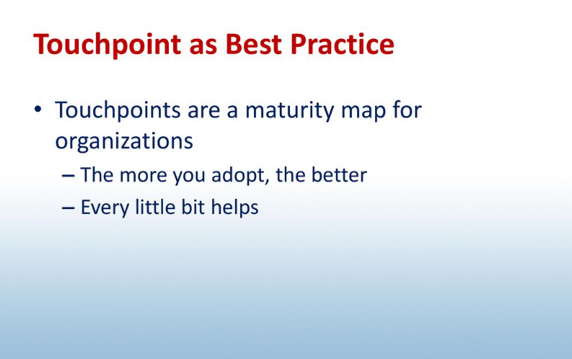
Best Practice

Slide 19
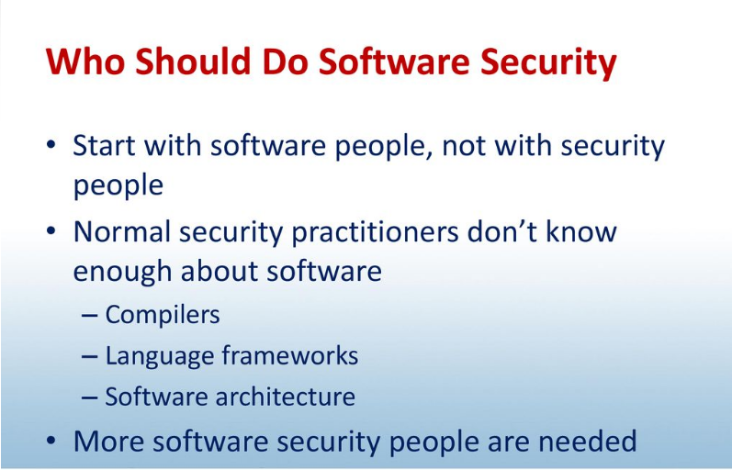
Best Practice

